Slide 1
JavaScript
Authored by : Karan D. Presented by : Karan D.

Slide 2
A Quick Background
HTML – Building blocks of a web page.
CSS (and CSS preprocessors) – Styling web pages.
JS (and libraries – jQuery, YUI etc.) – Scripting on the client side.
AJAX – Allows for feature rich web pages.

Slide 3
JavaScript

Slide 4
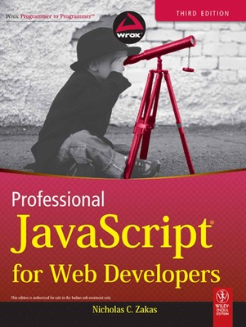
What references to use?

Slide 5
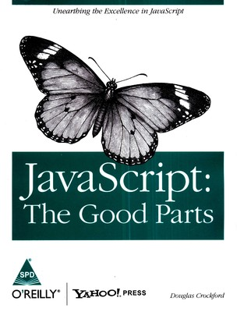
What references to use?

Slide 6
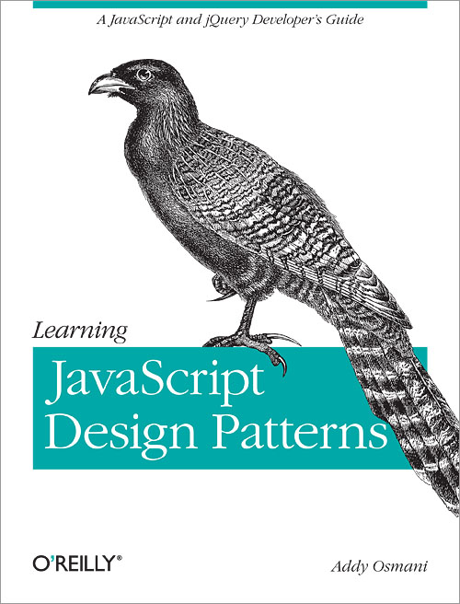
What references to use?

Slide 7
JavaScript
JavaScript is a scripting language designed to add interactivity to HTML pages.
It is an interpreted language.
You can use it to:
  React to events
  Manipulate HTML elements
  Validate data
  Detect the browser
Note that Java and JavaScript are not related.

Slide 8
<script> tag and variables
To fire any js statements, use the <script></script> tag:
  <script type="text/javascript">
  alert ("Hello World!");
  </script>
  The alert() here throws an alert message.
Script tags can be placed in head or body. (but why?)
To include external js:
  <script type="text/javascript" src="myscript.js"></script>
Variables are created using ‘var’ keyword:
  var msg = “Hello World!”;
  var age = 21;

Slide 9
Arithmetic Operators
Arithmetic Operators
Operator | Description
+ | Addition
- | Subtraction
* | Multiplication
/ | Division
% | Modulus
++ | Increment
-- | Decrement

Slide 10
Assignment Operators
Assignment Operators
Operator | Description
= | Assign
+= | Add and assign
-= | Subtract and assign
*= | Multiply and assign
/= | Divide and assign quotient
%= | Divide and assign remainder

Slide 11
Comparison Operators
Comparison Operators
Operator | Description
== | Equal to (value)
=== | Equal to (value and type)
!= | Not equal to (value)
!== | Not equal to (value and type)
> | Greater than
< | Less than
>= | Greater than or equal to
<= | Less than or equal to

Slide 12
Logical Operators and Conditional Operator
Logical Operators
Conditional Operator
    <variable> = (condition) ? <value1> : <value2>
    var status = (marks < 33) ? ‘Fail’ : ‘Pass’;
Operator | Description
&& | And-ing
|| | Or-ing
! | Not-ing

Slide 13
Concatenation
+ is also used to concatenate strings.
    var msg1 = “Hello”;
    var msg2 = “ World!”;
    var msg3 = msg1 + msg2;
    alert(msg3);

Slide 14
If … else
This looks like:
    if (condition1) {
    …
    }
    else if (condition2) {
    …
    }
    else {
    …
    }
Note the space in ‘else if’

Slide 15
Popup Boxes
Alert Box
  alert(<text>);
  To display a message.
  Only has Ok button.
Confirm Box
  confirm(<text>);
  To confirm something.
  Has Ok button (true) and Cancel button (false).
Prompt Box
  prompt(<text>, <defaultvalue>);
  To get some input from user.
  Input, Ok button and Cancel button (null).

Slide 16
Functions and Lifetime of variables
These look like:
    function <functionname>(<arg1>, <arg2>) {
    …
    return <somevalue>;
    }
Variables defined inside functions (local variables) are only accessible inside that function. Lifetime ends when function ends.
Variables defined outside functions (global variables) are accessible across all functions and scripts on that page. Lifetime ends when the page is closed.

Slide 17
Loops
for
  for (<var> = <value>; condition; <var> = <var> + <increment>) {
  …
  }
while
  while (condition) {
  …
  }
do while
  do {
  …
  } while(condition);

Slide 18
Break, Continue statements and Comments
break is used to break out of a loop
continue will break the current loop and move to the next value
Comments can be made using // or /* … */:
  <script type="text/javascript">
  // document.write("<p>Hello World!</p>");
  / *
  document.write("<p>Hello World!</p>");
  document.write("<p>Hello World!</p>");
  */
  </script>

Slide 19
Events - 1
Actions detectable by JavaScript.
Allows in creating dynamic web pages.
Defined inside the HTML tags.
Normally used in combination with functions.
For example:
  <input type="button" onclick="alert('Hello');" value="Say Hello“ />

Slide 20
Events - 2
Events
Event | Description
onmousedown | On pressing mouse button on an element
onmouseup | On releasing mouse button on an element
onclick | On clicking an element
ondblclick | On double-clicking an element
onmouseover | On moving mouse pointer onto an element
onmousemove | On moving mouse pointer over an element
onmouseout | On moving mouse pointer off an element
onload | On load of an object
onunload | On leaving the page (only <body> , <frameset>)
onresize | When element gets resized

Slide 21
Events - 3
Events
Event | Description
onfocus | When a form element gets focus
onchange | When content, checked state or selection of a form element changes
onblur | When a form element loses focus
onsubmit | On page submit

Slide 22
JavaScript Objects
JavaScript is an Object Based Programming language.
It offers certain built-in JavaScript objects:
  JS Array
  JS String
  JS RegExp
  JS Date
  and more …
Objects have methods and properties.

Slide 23
JS Array – 1
Created by:
  var cars = new Array(“Swift",“Indica",“A-Star");
  var cars = [“Swift",“Indica",“A-Star"];
Use length property to get array length:
  alert(cars.length);
There are also some useful methods.

Slide 24
JS Array – 2
Methods
Method | Description
push() | Adds element at the end (and returns new length)
pop() | Removes last element (and returns that element)
unshift() | Adds element at the start (and returns new length)
shift() | Removes first element (and returns that element)
concat() | Returns multiple arrays joined together
sort() | Sorts all elements
reverse() | Reverses the order of elements
join() | Returns a string will all the elements joined
slice() | Returns an array slice

Slide 25
JS String - 1
Created by:
  var msg = new String(“Hello World!");
  var msg = “Hello World!”;
Use length property to get string length:
  alert(msg.length);
There are also some useful methods.

Slide 26
JS String - 2
Methods
Method | Description
toLowerCase() | Converts string to lowercase.
toUpperCase() | Converts string to uppercase.
match() | Matches a regex and return the matches (returns null if no match)
search() | Matches a regex or specified value and returns the position of the match (returns -1 if no match)
replace() | Matches a regex or specified value and returns new string with specified value replaced.
spilt() | Returns an array with string split by separator.
substr() | Returns a string starting at specified position and upto length specified.

Slide 27
JS RegExp
Created by:
  var regex = new RegExp(pattern, modifiers);
  var regex = /pattern/modifiers;
test() returns true if there is a match else returns false
  var str = “Hello World!”;
  var regex = /hello/i;
  var exists = regex.test(str);
exec() returns matched text else returns null
  var str = “Hello World!”;
  var regex = /hello/i;
  var result = regex.exec(str);

Slide 28
JS Date - 1
Created by:
  var d = new Date();
  var today = new Date(); // current date and time
  var d = new Date(milliseconds);
  var date = new Date(1000); // 1 second since 1970/01/01
  var d = new Date(dateString);
  var date = new Date("October 13, 1975 11:13:00")
  var d = new Date(year, month, day, hours, minutes, seconds, milliseconds);
  var d = new Date(1975, 9, 13); // Not specifying causes 0 to be passed in
There are also some useful methods.

Slide 29
JS Date - 2
Methods
Method | Description
getTime() | Returns number of milliseconds since midnight Jan 1, 1970
getFullYear() | Returns the year (four digits)
getMonth() | Returns the month (from 0-11)
getDate() | Returns the day of the month (from 1-31)
getDay() | Returns the day of the week (from 0-6) [Sunday being 0]
getHours() | Returns the hour (from 0-23)
getMinutes() | Returns the minutes (from 0-59)
getSeconds() | Returns the seconds (from 0-59)
getMilliseconds() | Returns the milliseconds (from 0-999)

Slide 30
JS Date - 3
Methods
Method | Description
setTime() | Sets date by adding / subtracting specified milliseconds to / from midnight Jan 1, 1970
setFullYear() | Set the year (four digits)
setMonth() | Sets the month (from 0-11)
setDate() | Setns the day of the month (from 1-31)
setHours() | Sets the hour (from 0-23)
setMinutes() | Sets the minutes (from 0-59)
setSeconds() | Sets the seconds (from 0-59)
setMilliseconds() | Sets the milliseconds (from 0-999)

Slide 31
HTML DOM

Slide 32
HTML DOM
The HTML DOM (Document Object Model) is a standard for how to get, change, add, or delete HTML elements.
It is:
  A standard object model for HTML.
  A standard programming interface for HTML.
  Platform and language independent.
  A W3C (World Wide Web Consortium) standard.
The HTML DOM defines the objects and properties of all HTML elements and the methods to access them.

Slide 33
DOM Nodes
The DOM says:
  The entire document is a document node.
  Every HTML element is an element node.
  The text in the HTML elements are text nodes.
  Every HTML attribute is an attribute node.
  Comments are comment nodes.
So the entire html page can be considered as a tree.
And so you’ll have parent, children and sibling relationships.

Slide 34
Accessing Elements
Nodes can be accessed like so:
  getElementById() - returns the element with the specified ID
  var div = document.getElementById(“mydiv”);
  getElementsByTagName() - returns all elements with a specified tag name var divs = document.getElementsByTagName(“div”);
  getElementsByName() - returns the element with the specified name
    var divs = document.getElementsByName(“mydiv”);
  Navigating node tree using node relationships – different properties such as parentNode, childNodes, firstChild , lastChild, nextSibling and previousSibling allow us to traverse through the document.
  var parent = document.getElementById(“mydiv”).parentNode;

Slide 35
Changing Elements
Changing html
  var html = document.getElementById(“mydiv”).innerHTML;
  document.getElementById(“myotherdiv”).innerHTML = html;
Changing attributes
  var value = document.getElementById(“myinputname”).value;
  document.getElementById(“myinputname”).value = value;
Changing appearance
  var color = document.getElementById(“mydiv”).style.color;
  document.getElementById(“myotherdiv”).style.color = color;

Slide 36
Adding and removing elements
To create an element:
  var mydiv = document.createElement(“div”);
To add an element to the document:
  document.body.appendChild(mydiv);
To remove and element from the document:
  document.body.removeChild(mydiv);

Slide 37
Validate inputs
//samplejsdom.html
//validate inputs
We make use of the following here:
HTML DOM
Change the style of spans
Use js functions, arrays, onclick event and regex

Slide 38
Bibliography, Important Links
Professional JavaScript for Web Developers - http://edc.tversu.ru/elib/inf/0229.pdf
MDN Tutorials
  All of the front end tutorials you would need on HTML/CSS/JavaScript - https://developer.mozilla.org/en-US/docs/Web/Tutorials
  A re-introduction to JavaScript - https://developer.mozilla.org/en-US/docs/Web/JavaScript/A_re-introduction_to_JavaScript

